Slide 1
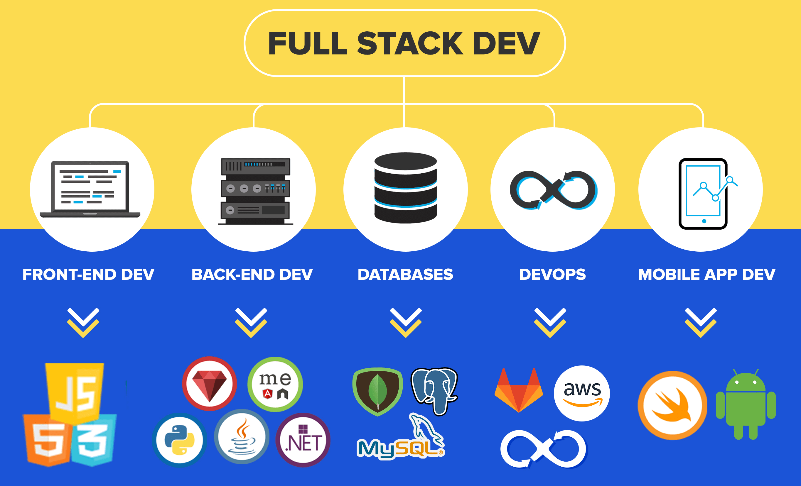

Slide 2











Slide 3
Course Objectives:
To familiarize with various technologies like HTML, CSS, JavaScript, XML, JSP and PHP to develop real-time web applications.
Course Outcomes:
identify various HTML tags and their purpose
develop dynamic web pages using HTML, CSS and Javascript
use XML to store and transport data
design web applications using JSP and PHP
connect to heterogeneous databases using JSP as well as PHP

Slide 4
Unit 1 – HTML & CSS
Unit 2 – JAVASCRIPT. JQuery & Bootstrap
Unit 3 – JSP and JDBC
Unit 4 –PHP Programming and MYSQL
Unit 5 –ReactJS

Slide 5
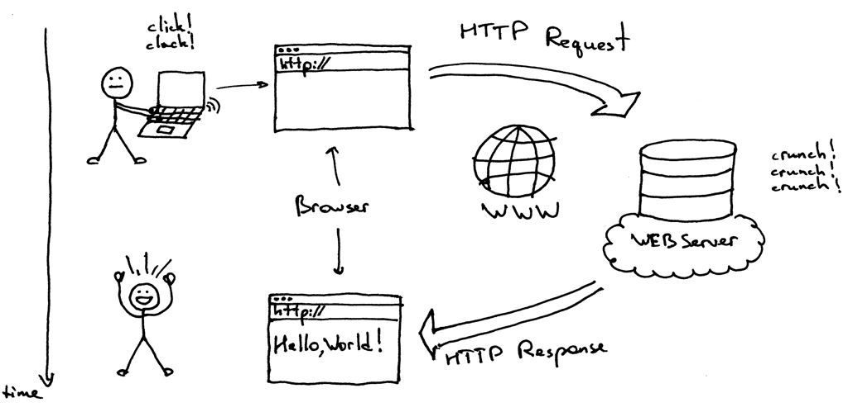

Slide 6

HTML:
Introduction
Basic HTML Tags
Lists
Tables
Forms
Frames
IFrames
Images
CSS:
CSS rules
Selectors
Types of CSS
CSS Properties

Slide 7
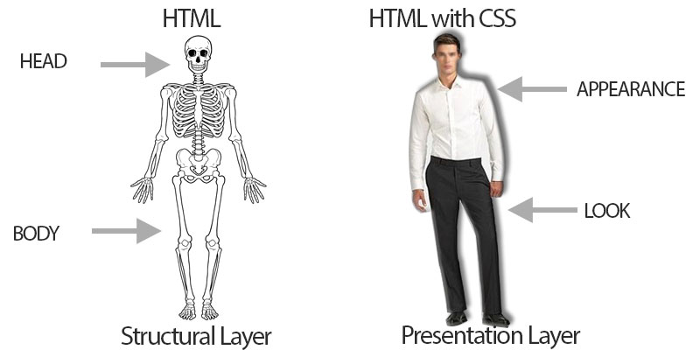

HTML Vs HMTL+CSS

Slide 8
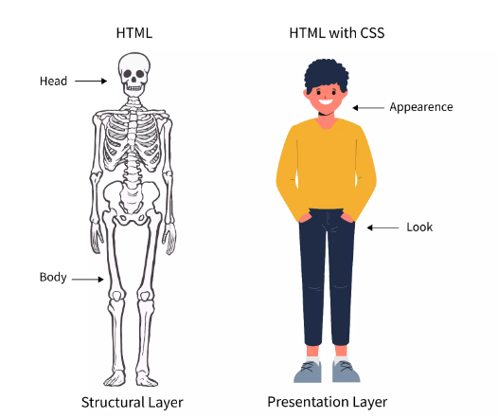
HTML Vs HMTL+CSS

Slide 9

A Style sheet is a set of Stylistic rules that expresses the Presentation and Layout of Structured documents (Web Pages).
Expresses the Presentation Semantics (Style and Layout) of a Web page
Separates content from Presentation

Slide 10
CASCADING STYLE SHEETS (CSS):
Using CSS we can determine the style and layout of the web page.
CSS is a style sheet language used to describe the presentation semantics of a document written in Markup Language.
They allow us to specify rules for how the content of elements within your document appears.
With CSS, all formatting could be removed from the HTML document and stored in a separate CSS file.

Slide 11
Advantages:
  Improves the formatting capability of a HTML page
  Reduced Document size
  Reduced Complexity and repetition – can reuse the same style sheet with many different HTML documents.
  Saves time
  A style sheet can import and use styles from other style sheets.

Slide 12
CSS Rule Syntax:
  Selector {
  Property1: value;
  property2: value;
  }
1)single selector 2)Multiple selectors
H1{
text-align:center; color:red; //sin
text_transform:uppercase;
}
h1,pre{
text-align:center;
color:red;
text_transform:lowercase;
}

Slide 13
Class Selector / Stylesheet class:
  Selector.classname
  { Property1: value;
  property2: value; }
  h1.my{
  text-align:center;
  color:red;
  font-size:25px;
  background-color:yellow;
  }
  .mystyle{
  text-align:center;
  color:blue;
  font-size:25px;
  background-color:pink;
  }

Slide 14
Id Selector:
  Selector # id
  { Property1: value;
  property2: value; }
Example: myid.html
#my {
text-align:center;
color:blue;
font-size:25px;
background-color:pink;
} </style>
</head>
<p >This paragraph tag <p>
<p id ="my">This paragraph will be affected.</p>
<h1> this a Heading tag</h1>
<h1 id="my"> > Welcome to the HTML with CSS </h1>

Slide 15
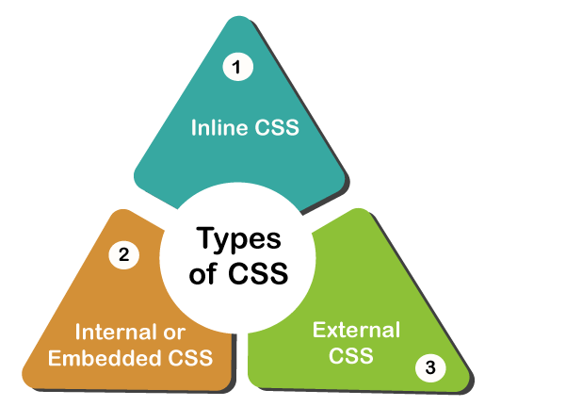
TYPES OF CSS

Slide 16
TYPES OF CSS
Inline CSS:
  “Style” attribute is used
  Syntax: <tagname style=“ Cssproperty1:value;
  Cssproperty2: value” >
Internal CSS:
  Head section of the same document
  <style> tag is used
External CSS:
  CSS rules stored in a separate file saved as .css
  <link > tag is used to link .css file to HTML page

